Slide 1


Spring Online Conference 2023
The Ripple Effect
Conor Campbell
Senior Manager, Safe and Effective Care

Slide 2
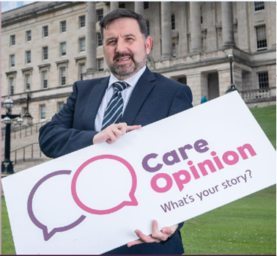
Aug
2020
We are now almost 3 years old – walking, talking, making noise and causing a lot of disruption – all very positive!
Launch
The journey
so far
1,440
Each personal journey shared validates good performance and / or provides valuable learning and the opportunity to make positive change.
Stories
546
Each trained and active responder has become a user experience change agent and has increased their interaction with our full set of user experience tools.
Responders
NI Health Minister launching Care Opinion
100%
We pride ourselves on speed of response, sharing of stories to the frontline, full transparency and commitment to working in partnership to learn and resolve issues.
Responsiveness

Slide 3
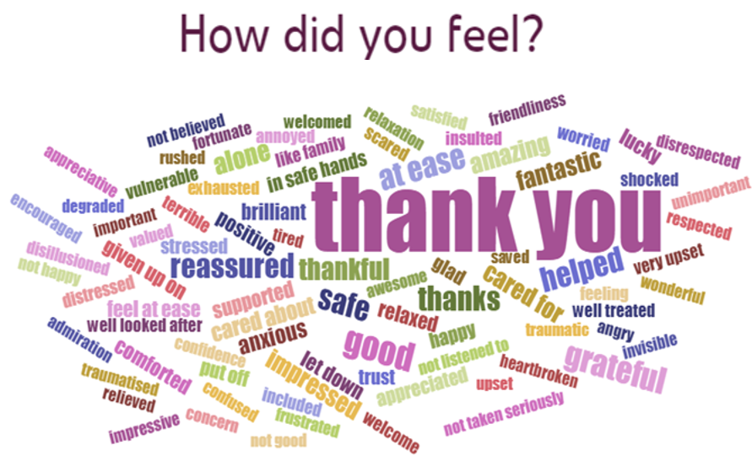
Quick response made to acknowledge and thank the story author for positive comments submitted and to describe how the story has been shared.
Recognise the positive
How we use Care Opinion
An early response is made to acknowledge the negative story, apologise for shortcomings and to offer personal level review to guide responsive action.
Respond to the negative
A4 colour laminated story templates are produced and displayed at service location for every positive story. Stories are highlighted on Trust social media.
Celebrate good care
Story authors are invited to be personally involved in active response to all negative stories. A turnaround template transparently displays response journeys.
Active response

Slide 4

Care Opinion is used as a value-adding resource in combination with intel from further experience tools to provide a comprehensive lens of service user experience.
Triangulate
How we use Care Opinion
Care Opinion interacts with our service user involvement models – sparking initiatives to drive exploration and improvement of key experience elements.
Integrate
Care Opinion supports elevation and prioritisation of the service user experience that has ramped up the organisation’s focus and commitment to excellence.
Elevate
Care Opinion is proving to be a key catalyst in creatively and effectively improving the service user experience in partnership with our story authors.
Innovate

Slide 5
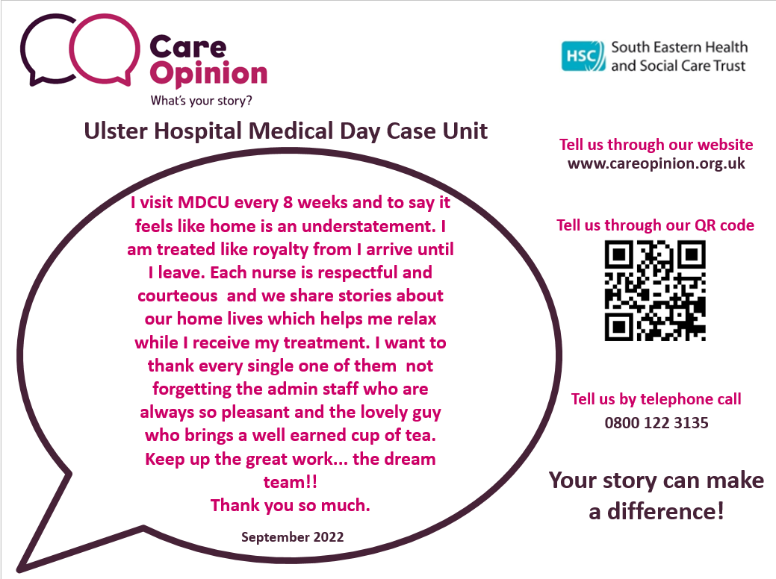
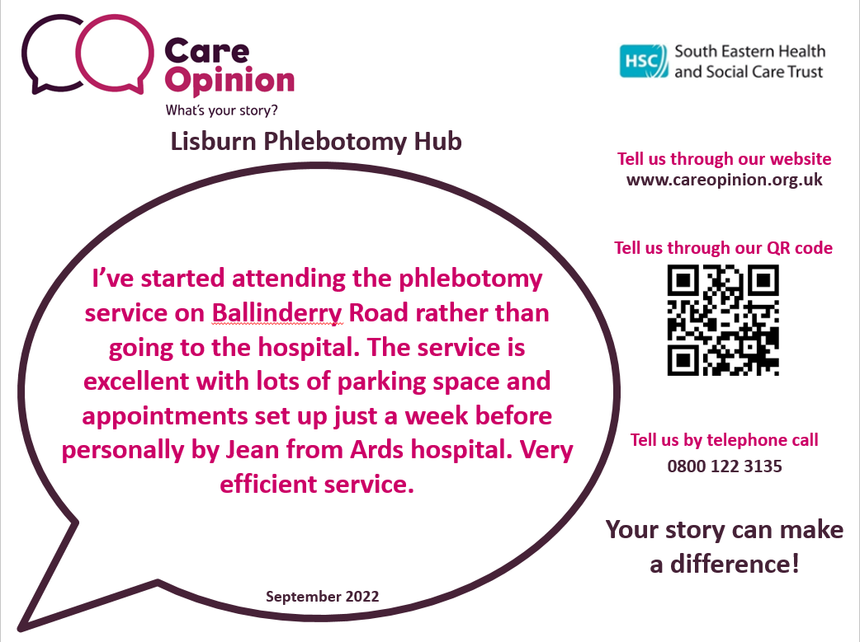
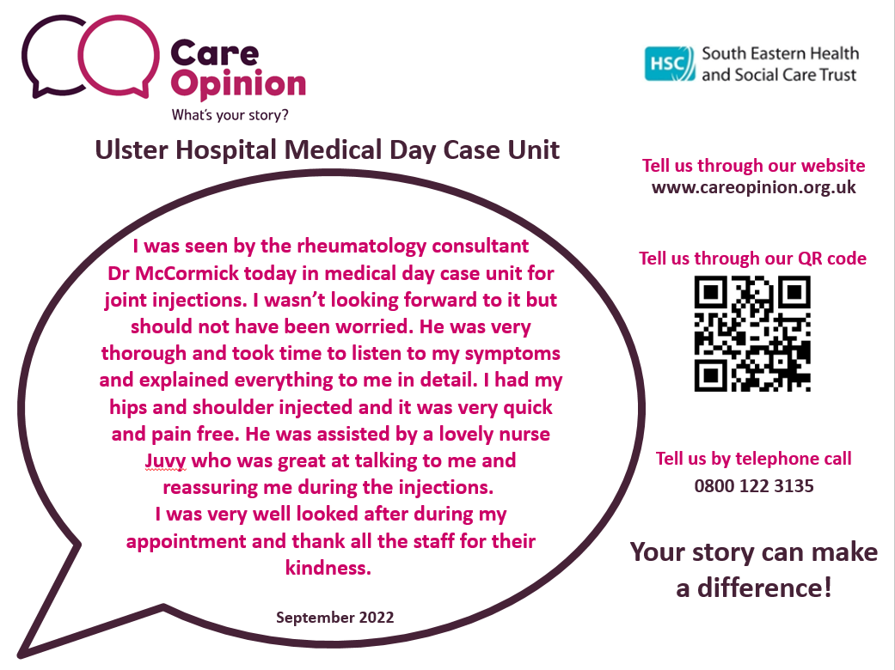
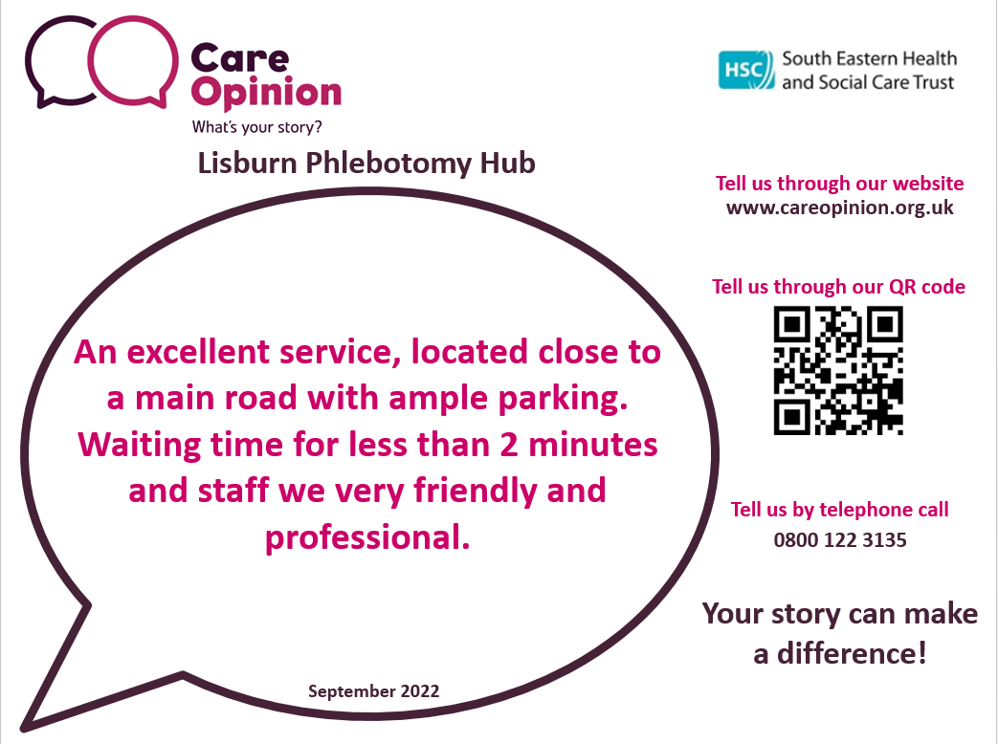


Story Quotes
Turnaround Stories
Examples of the A4 colour laminate positive quote templates displayed at every service location

Slide 6


Wrongly informed of my injury
- Emergency Department, Ulster Hospital
Tell us through our website
pinkyjq87 said…
www.careopinion.org.uk
I felt that I had a rib fracture and attended ED. I have a complex medical history as a cancer survivor who has had radiotherapy and chemotherapy. Fractures are a delayed effect associated with radiotherapy. My GP letter states that a fracture has occurred but I was not personally told this following my x-ray when being seen by the doctor. This affects how my carer would look after me.
Tell us through our QR code
May 2023
What we did…
We reached out to pinkyjq87 and invited personal level review of her care journey along with apology for shortcoming in care. Pinkyjq87 agreed to personal level review and we brought her in for review and discussion and provided supporting information to help pinkyjq87, her carer and her GP manage her associated care effectively. We discussed as a wider team in respect of learning re: good communication and thorough consideration of patient care needs as per their injury and / or condition.
Tell us by telephone call
0800 122 3135
Your story can make a difference!
Example of Turnaround Story display template. This has proven to be a fair and effective way of transparently sharing negative stories once staff have taken responsive action to resolve the issues.

Slide 7

Service users value the opportunity to tell their story fully in their own words with the option of anonymity.
I could tell my story
Impact on service users
Service users value that staff welcome their story, receive and respond to the story openly and warmly in a safe space to do so. It is so important to feel listened to.
My voice was welcomed
Service users appreciate how we share their positive stories and how we deliver a personal-level and sincere active response to all negative stories.
The response was good
Service users appreciate the transparency of sharing turnaround stories and the efforts made to use their stories for shared learning in order not to repeat mistakes.
The power of my story

Slide 8

Staff enjoy seeing
recognition of their good care and take great pride in receipt of team and individual praise – especially those who may not often hear it.
Recognition
Impact on staff
It is very touching for staff to see how much it means for service users and families to have been treated with dignity, respect and compassion.
The personal touch
Staff really value stories telling of positive outcomes due to staff contribution – particularly when the story tells how quality of life has been supported or improved.
Outcome
Individuals and teams find it very motivating to have a live record of performance feedback - this drives high standards for safe, effective and compassionate care.
Motivation

Slide 9

Care Opinion has helped to elevate the user voice to its rightful standing which, in turn, has elevated the staff sense of responsibility to act responsively.
Responsibility
Impact on culture
Using transparent display of positive stories and then adding transparent display of turnaround stories has made for an easy and balanced value-adding journey.
Transparency
Initial staff apprehension regarding what Care Opinion would throw up has evolved into a safe and fair journey of validation, pride and motivation.
Fear becomes win
Staff enjoy their growing Care Opinion display areas and dedicated campaigns – with late adopters feeling left out and wanting in on the action.
Rewarding

Slide 10
Snapshot Impacts
Mental Health
Internal sharing (AD, Gov Ld)
External (Govt., Cond. Mgt Funders, F/book, Twitter)
Inpatients, Medicine
Inpatient pillows / linen additional provision to ensure always ample access
Inpatients, Surgical
Positive feedback always shared to relevant teams. Reinforces good practice
Vaccination Centre
Review and improvement of flow system actioned at Vaccination Centre
Inpatients, Medicine
Change in analgesia administration to support pain management timeliness
Inpatients, Maternity
Focus on discharge to ensure optimised balance between no undue delay nor rush
Hospital Services, Children
Rapid access to consultant review appointment for complex needs child
Inpatients, Medicine
User feedback reviewed and learning opportunities utilised – staff enjoy hearing feedback
Maternity Services
Using feedback to promote importance of HSC values and behaviours
Vaccination Centre
Improved
hospital site signage
put in place
Inpatients, Children
Focus on information provision to parents
Emergency Department
Learning shared through staff closed Facebook group – good for morale
Mental Health
Effect of feedback has helped embed Condition Mgt Programme and Virtual Workshops
Impact at service level: Impacts such as these have not only resolved the immediate issues but have also served to support the ripple effect across the organisation – promoting the use and power of Care Opinion and the importance of listening and responding to the service user voice – in partnership with service users and families.

Slide 11
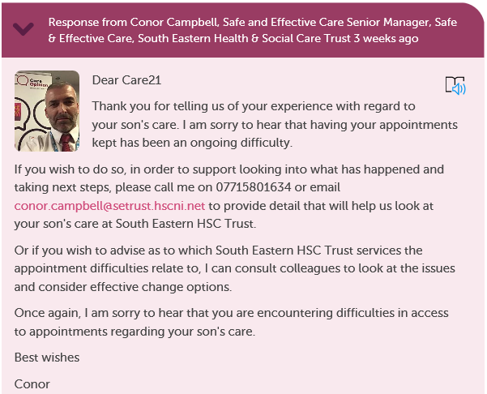
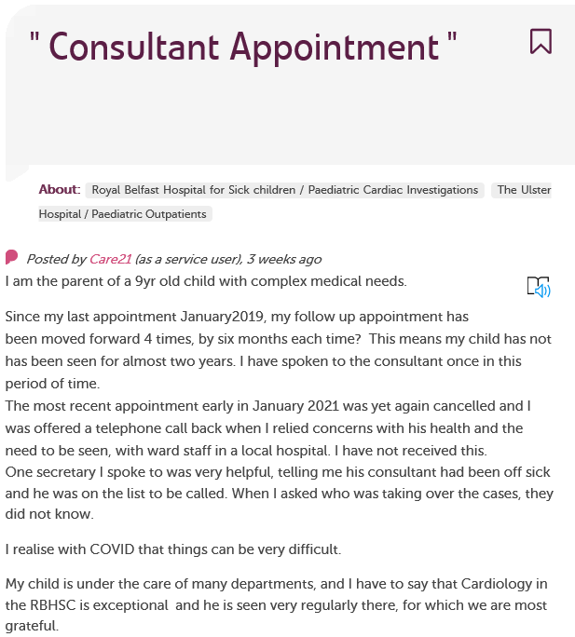
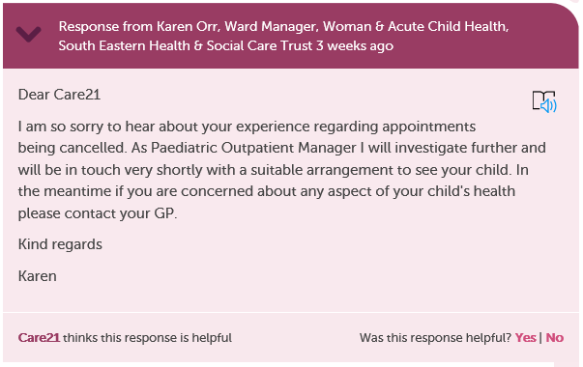
.
PATIENT
STORIES
Telephone call held with patient’s mother.
Information gathered to support review of individual case. Management and clinician input resulted in liaison with mother and appointment arranged.
Example of Impact at Individual Level

Slide 12

.
Impact at Service Level
My stay in hospital over Christmas
I was admitted to Ulster Hospital Ward 9 for a week over Christmas.
The care that I received was outstanding from the doctors and nurses on Ward 9 along with staff in ED, ultrasound and other departments. Nothing was ever a hassle to them.
Special mention to Nicole & Jill who looked after me for most of my stay.
On Christmas Day, the staff kept everyone’s spirits high and made sure we enjoyed the day as best we could.
In hospital during Covid, I felt safe and that the standard of care provided remained high.
UHD WARD 9
The care I received while in hospital
I was admitted to Ulster Hospital Ward 9 with a severe kidney infection.
I’ve have been treated with great kindness and the nurses have been nothing but amazing to me.
There is a nurse cared Sarah who was looking after me overnight.
I had been quite sick and feeling rotten and Sarah was extremely helpful and provided me with the best care. I am so grateful to have such lovely nurses looking after me.
Zoe - who is part of hospital at night team - always cheers me up with her beautiful bubbly personality.
I can't thank the girls enough for being absolutely brilliant.
Truly, thank you for everything.
Felt safe and cared for
I had broken my back so I couldn't move well during my stay in Ulster Hospital Ward 9.
I have never felt so safe and cared for. The Nursing staff in the ward were absolutely great.
They showed that they cared all the time - asking if I was okay every time they saw me, be it in passing or coming with my meds.
They were all so happy and fun.
They engaged in any conversation with you and still got on with their duties while they did so.
It was an all around great experience being with them in Ward 9.
My mother’s care
My mother was in
Ulster Hospital Ward 9.
Every single staff member went above and beyond.
They looked after her impeccably and were there to also lift her mood.
I felt relaxed in these terrible times knowing she was getting better every day and settled every night.
I can't thank Ward 9 enough.
They kept me up to date with every phone call and reassured me on all levels of procedures being carried out.
My mum is now home with everything in place which has taken a lot of stress and worry off my own shoulders.
Thank you to everyone on Ward 9.
Amazing staff
I want to thank the amazing staff at Ulster ED and Wards 9, 6A & 6C staff who made my stay less stressful. I couldn’t have met nicer nurses and doctors.

Slide 13

.
IMPACT OF
PATIENT STORIES
Bereavement Forum
Collation of end of life / bereavement stories has been used to inform Trust Bereavement Forum of family experience.
This has:
provided trust-level assurance
delivered recognition of service-level effective and compassionate performance
informed a change to be made
The change aim is:
to develop a single point of contact whereby one communication to the Trust will result in all healthcare aids from various teams being collected from the patient’s home and
that staff removing healthcare aids from the patient’s home will be informed that a death has taken place and to communicate sensitively with the family.
Trust Vaccination Centre
User feedback highlighted a range of difficulties to include
finding the centre
finding convenient parking
flow of activity within the centre.
Vaccination Centre and Patient Experience leadership reviewed site arrangements and introduced:
improved directional signage to the centre
improved directional signage to most convenient car parking area
improved centre operation flow arrangements introduced
Ongoing feedback receipt evidenced the positive impact of the changes made.
Impact at Organisation Level
These changes have powered the ripple effect across the organisation in terms of bereavement management and facility planning / operation.

Slide 14
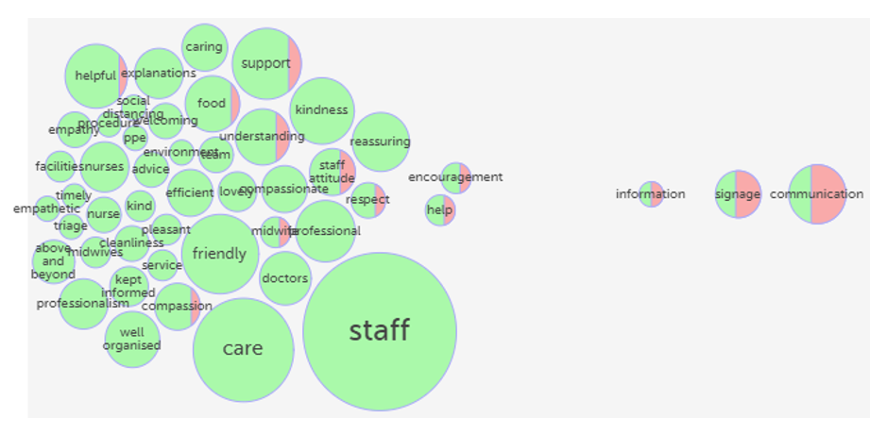
Use of visual features
Staff love to see the key words used to describe how service users felt about their contribution.
Word cloud
and
Tag bubble
The tag bubble allows us to clearly highlight hotspots for improvement in fair balance with all that is good.

Slide 15
To have a regular and deliberate pathway of sharing all Care Opinion learning and change across services.
Shared learning
To develop a learning library of examples of good practice and turnaround journeys for all staff to contribute to and access from.
Learning library
Next steps
To continue to creatively promote Care Opinion to enhance story volume – particularly in areas of lower participation (prison health, social care, mental health).
Promotion
To hold an Involvement and Experience Conference to celebrate and showcase the successes and further potential of Care Opinion and partnering resources.
High level celebration

Slide 16
Spring Online Conference 2023
The Ripple Effect
Conor Campbell
Senior Manager, Safe and Effective Care

