Slide 1
Realistic Medicine
Looking forward: How might online feedback support policy and strategy?
Stephen Martin
Realistic Medicine Team Leader
Care Opinion Policy Webinar 5 October 2023

Slide 2
Background
Concerns
Widening of healthy life years gap
Climate emergency
Threat of future pandemics
Industrialised health care

Slide 3
OECD report on waste:
one fifth of healthcare
spend has NO impact

Slide 4
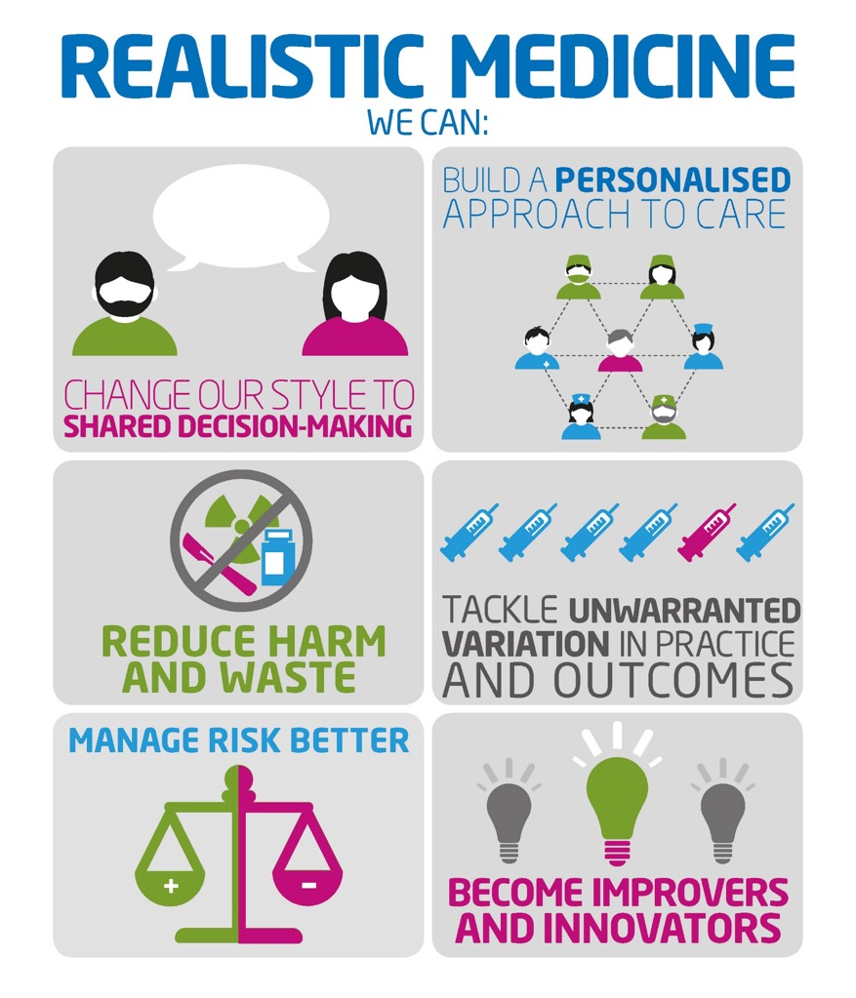

Slide 5
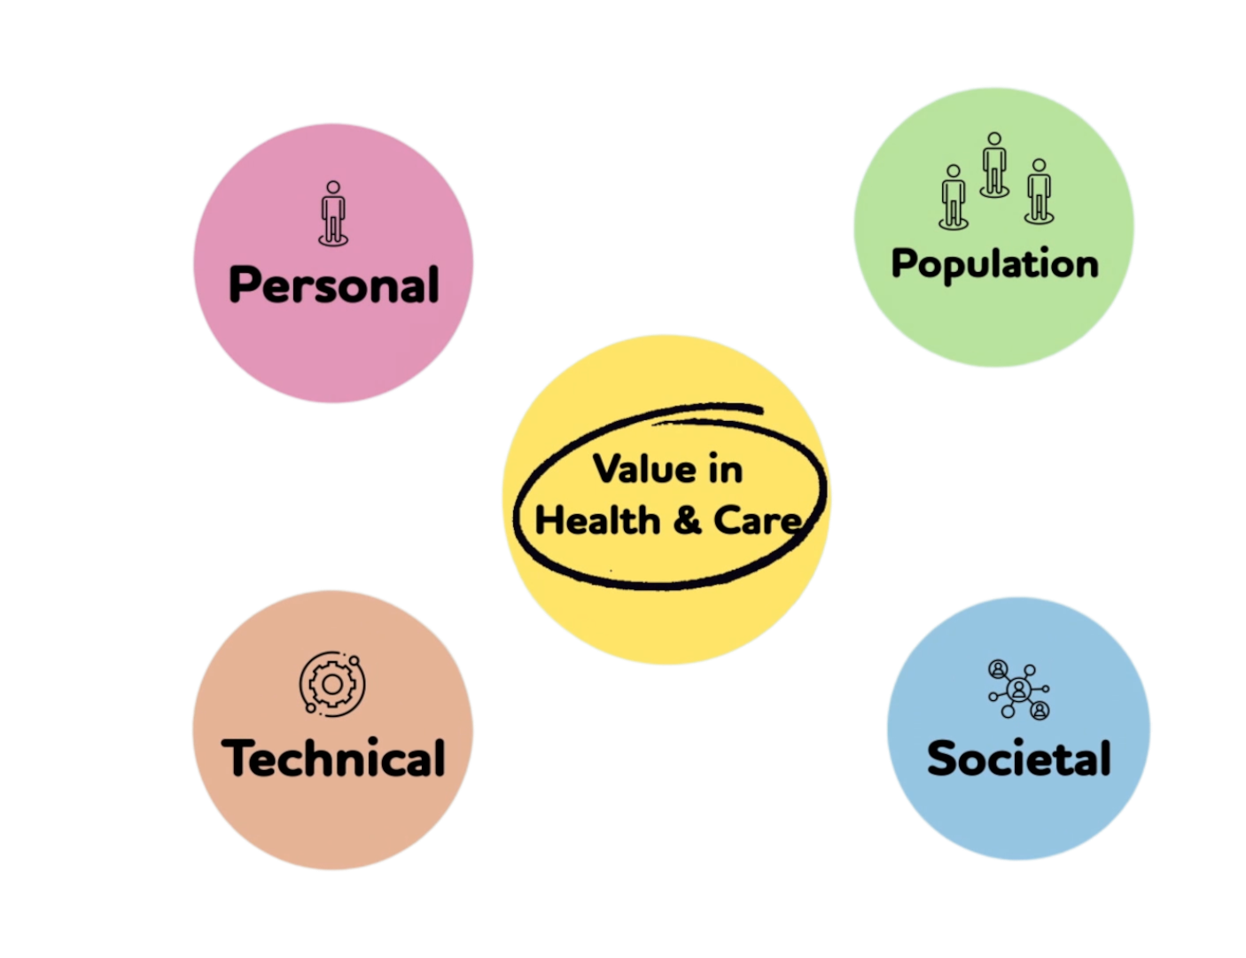

Slide 6
Our definition:
Value based health and care delivers better outcomes and experiences for the people we care for through equitable, sustainable, appropriate and transparent use of available resources.

Slide 7
Value Based Health and Care

Slide 8
Collaboration

Slide 9
Collaboration

Slide 10
VBH&C - Measurement
Why it is important to measure
VBH&C Commitment – PROM and PREM
Qualitative analysis – Care Opinion!

Slide 11
Thank you

