Slide 1
10 years of Care Opinion in NHS Scotland 2013-2023

Slide 2
Embrace radical new collaborative culture throughout our public services
Public services that are more responsive to the needs of individuals and communities

Slide 3
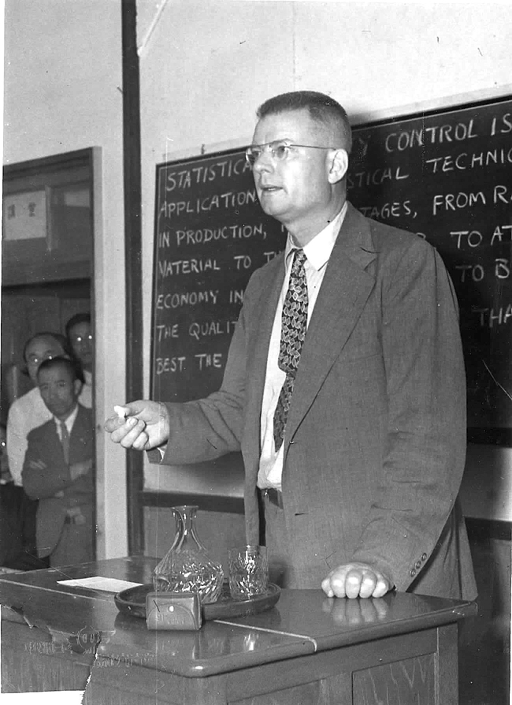
“The greatest waste… is failure to use the abilities of people… to learn about their frustrations and about the contributions they are eager to make.”
W. Edwards Deming
Out of the Crisis

Slide 4
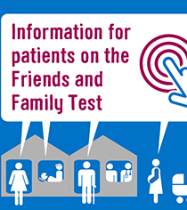
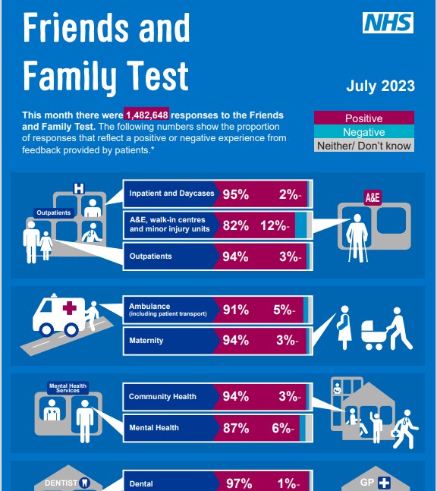

Slide 5
Different data sources
“The other thing I didn’t raise and I should have done because it does annoy me intensely, the time you have to wait for a bedpan [bed toilet]….Elderly people can't wait, if we want a bedpan it’s because we need it now.
I just said to one of them, ‘I need a bedpan please.’ And it was so long bringing it out it was too late.
It’s a very embarrassing subject, although they don't make anything of it, they just say, ‘Oh well, it can't be helped if you’re not well.’ And I thought, ‘Well, if only you’d brought the bedpan you wouldn't have to strip the bed and I wouldn't be so embarrassed.’ Betty
Patient questionnaire
Overall, did you feel you were treated with respect and dignity while you were in hospital?
Yes, always
Overall, how do you rate the care you received?
Excellent
Robert G. (2013) ‘Participatory action research: using Experience-based Co-design (EBCD) to improve health care services’. In: S Ziebland, J Calabrase, A Coulter and L Locock (eds). Understanding and using experiences of health and illness, Oxford; Oxford University Press

Slide 6
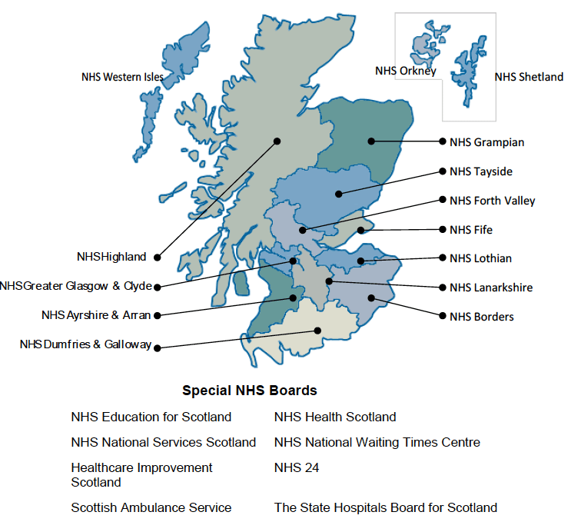

Slide 7
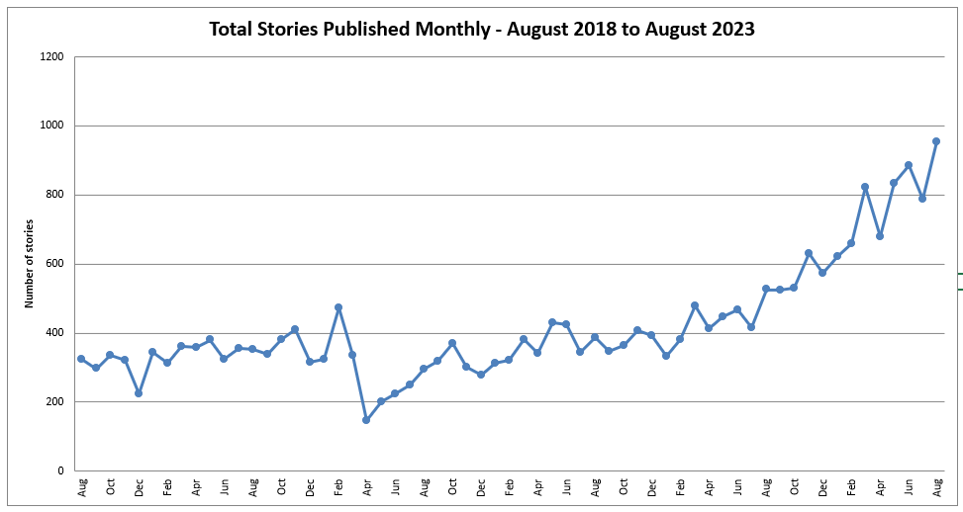

Slide 8
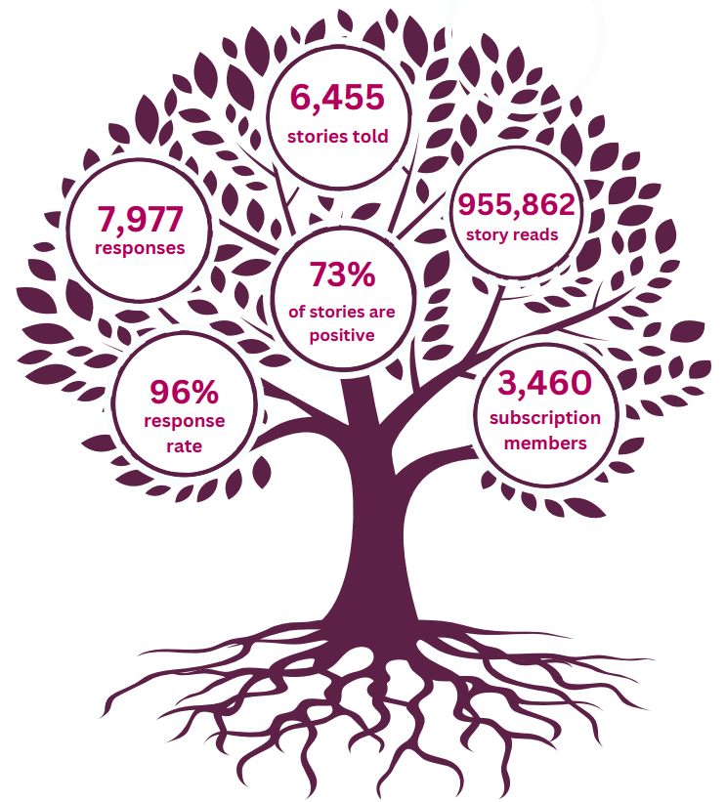

Slide 9
Care Opinion in Scotland the next 10 years…

Slide 10
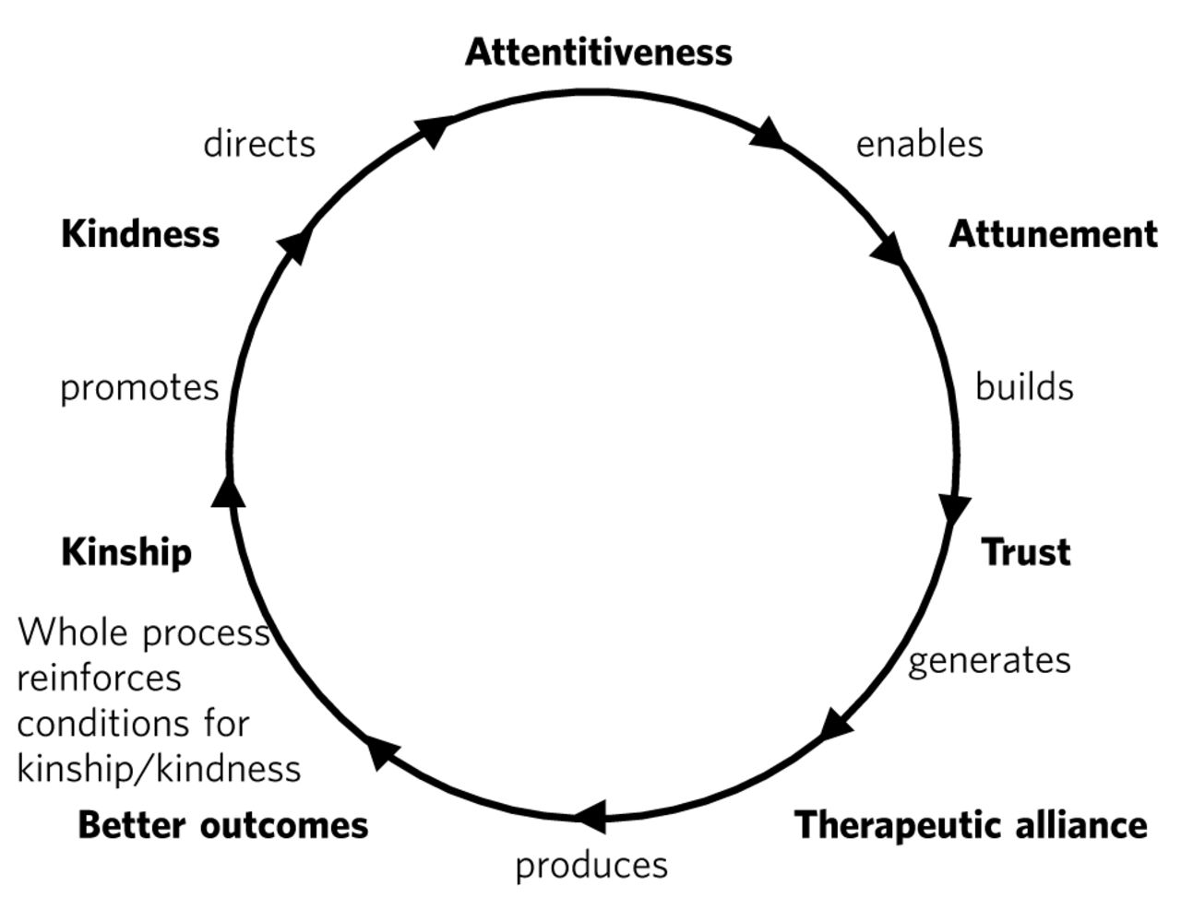
Intelligent Kindness: reforming the culture of healthcare (Ballat and Campling 2011)
Notes:
Image form HIS NHS Scotland WMTY resources. Free for re-use.

Slide 11
“The greatest waste… is failure to use the abilities of people… to learn about their frustrations and about the contributions they are eager to make.”
W. Edwards Deming
Out of the Crisis

Slide 12
More promotion & staff responding at point of care
Deepening understanding of benefits for staff wellbeing & organisational culture
Routine systematic use in policy, strategy, safety & QI
“Staff Opinion”?

Slide 13
“..transforming systems is ultimately about transforming relationships among people who shape those systems. Many otherwise well-intentioned change efforts fail because leaders are unable or unwilling to embrace this simple truth”
Senge et al. (2015), The dawn of system leadership,
Stanford Social Innovation Review, winter pp.27-30
Notes:
Reflections on the video from the room.
Peter Senge is a global thought leader in the field of developing high-performing, continually learning and improving organisations. His headline message: Its all about people and relationships.

