Slide 1

Patient Feedback –why bother?
Setting the national context
Jason Leitch
Clinical Director
The Quality Unit, Scottish Government
@jasonleitch

Slide 2



Slide 4
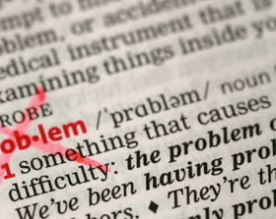
Problems
Patient safety problems exist throughout the NHS
Fear is toxic to both safety and improvement
With too many in charge,
no one is
NHS staff are not to blame
Incorrect priorities do damage
Notes:
Patient safety problems exist throughout the NHS as with every other health care system in the world.
NHS staff are not to blame – in the vast majority of cases it is the systems, procedures conditions, environment and constraints they face that lead to patient safety problems
Incorrect priorities do damage: Other goals are important, but the central focus must always be on patients
In some instances, including Mid Staffordshire, clear warning signals abounded and were not heeded, especially the voices of patients and carers
When responsibility is diffused is not clearly owned: With too many in charge, no one is.
Improvement requires a system of support: The NHS needs a considered, resourced and driven agenda of capability-building in order to deliver continuous improvement.
Fear is toxic to both safety and improvement:

Slide 5
Solutions
Improving the safety of patients
Quality of care & patient safety above all else
Engage & empower patients and carers
Foster staff development and growth
Embrace transparency unequivocally
Notes:
Place the quality of patient care, especially patient safety, above all other aims
Engage, empower, and hear patients and carers at all times
Fostering whole-heartedly the growth and development of all staff, including their ability and support to improve the processes in which they work
Embracing transparency unequivocally and everywhere, in the service of accountability, trust, and the growth of knowledge.
Recognise with clarity and courage the need for wide systemic change:
Abandon blame as a tool and trust the goodwill and good intentions of the staff
Reassert the primacy of working with patients and carers to achieve health care goals.
Use quantitative targets with caution. Such goals do have an important role en route to progress, but should never displace the primary goal of better care.
Recognise that transparency is essential and expect and insist on it
Ensure that responsibility for functions related to safety and improvement are vested clearly and simply
Give the people of the NHS career-long help to learn, master and apply modern methods for quality control, quality improvement and quality planning.
Make sure pride and joy in work, not fear, infuse the NHS

Slide 6
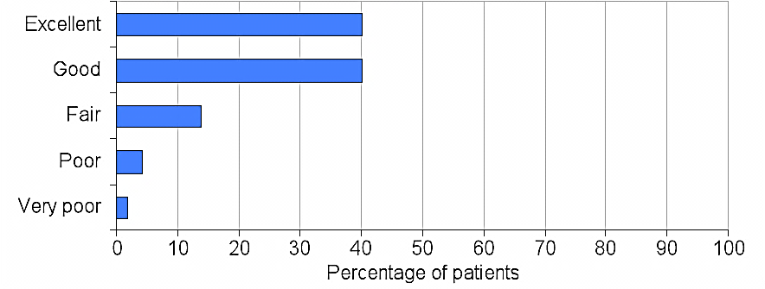
2012 Scottish Inpatient Patient Experience Survey
“Overall 80 per cent of patients rated their admission to hospital as either excellent or good”
Notes:
These results are from the 2012 Scottish Inpatient Patient Experience Survey.
The survey was sent to adult inpatients (aged 16 years old or above on discharge) who had an inpatient hospital stay between October 2010 and September 2011.
The majority of patients were positive about their experiences of admission to hospital. Overall 80 per cent of patients rated their admission to hospital as either excellent or good with no change since last year. However Accident and Emergency department (A&E) patients were less content regarding the information provided on waiting times in A&E; only 49 per cent of patients strongly agreed or agreed that they were told how long they would have to wait.

Slide 7


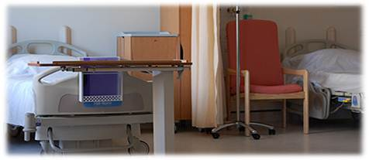
2012 Survey: Ward Environment
Cleanliness
Overall environment
Noise at night
Who is in charge of the ward?
Food and drink
Notes:
The results for patients’ experience of the hospital and ward environment were mixed. Areas where patients were most positive related to cleanliness, while patients tended to be most negative about noise at night, knowing who was in charge of the ward, and food and drink.

Slide 8


Slide 9
1941, William A. Foster
"Quality is never an accident; it is always the result of high intention, sincere effort, intelligent direction and skillful execution; it represents the wise choice of many alternatives.”
Notes:
9

Slide 10

What is Person-centred Care?
Patient and family experience
Staff experience
Co-production

Slide 11
Understanding the Patient Experience

Slide 12
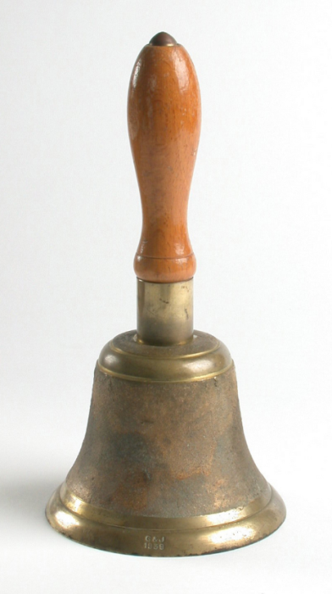

Slide 13
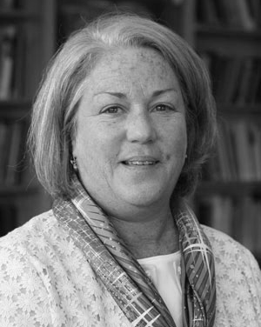
A Powerful Evolution
“Do it to me.
Do it for me.
Do it with me.”
Martha Hayward
Patient Advocate
Notes:
Martha Donovan Hayward joined the Institute for Healthcare Improvement (IHI) in March 2011 as the Lead for Public and Patient Engagement. The focus of her work at IHI is to bring patients and families into the design of all work at IHI to accelerate improvement by engaging patients and their families at all levels of care, design and decision making. A cancer survivor herself, she is a founding board member of the nonprofit Women’s Health Exchange and served on the Patient and Family Advisory Council of Dana-Farber Cancer Institute in Boston. Her career experience includes over 20 years in communications, marketing and fundraising in the areas of health, politics, and education. Most recently, as Executive Director at The Partnership for Healthcare Excellence, she brought a particular focus on, and considerable experience in, the area of patient advocacy.

