Slide 1
Can we “hear the patient voice at every level”? Yes, we can.
James Munro
Patient Opinion
james.munro@patientopinion.org.uk

Slide 2
Berwick Report, August 2013
“Hear the patient voice at every level – even when that voice is a whisper”

Slide 3
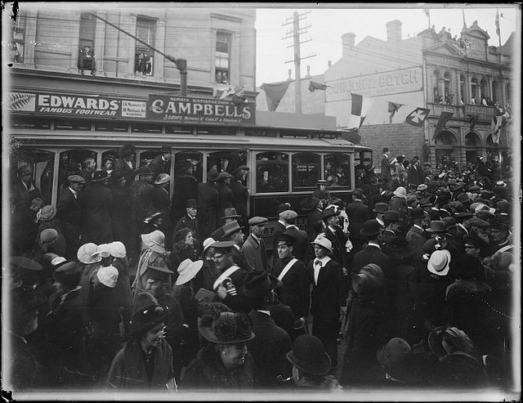
PEOPLE HAVE ALWAYS TALKED ABOUT YOU

Slide 4
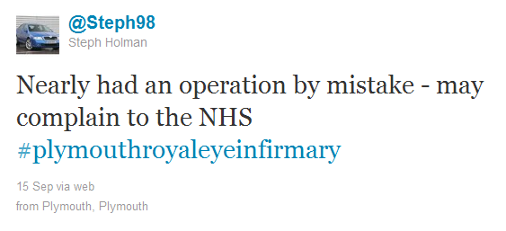
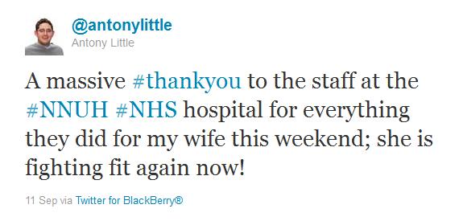

Slide 5
Blockers to feedback
When people are dissatisfied, only 5% go on to complain
Why?
“Nothing will be done”
32% (NAO, 2008), 25% (CQC, 2013)
“I will be seen as a troublemaker”
26% (CQC, 2013)

Slide 6
People are not wrong
“There is a lack of learning from complaints, and providers are not making clear to users that services are being improved as result.”
NAO, 2008
“More than half of those who had voiced a concern about poor care felt that their feedback wasn’t welcomed”
CQC, 2013

Slide 7
Imagine a world where
Service users and carers can give honest feedback safely and easily
Staff learn from knowing how their care is experienced
Services can make small, steady improvements based on feedback
Everyone can see how services are listening to users and changing in response

Slide 8
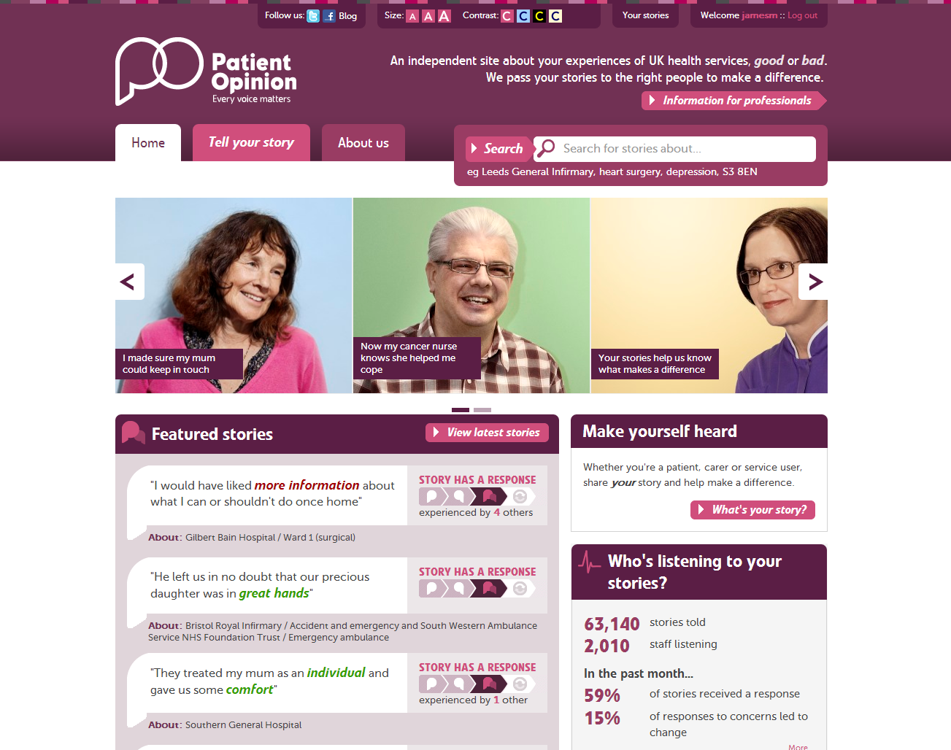

Slide 9
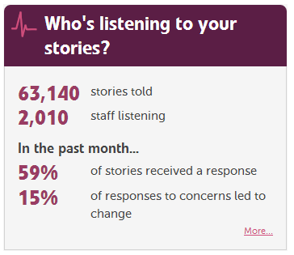

Slide 10
Patient and carer stories
Health and social care providers
Health boards, CHPs
NHS Scotland, MSPs,
Education
& research
Patient, carer and user bodies

Slide 11
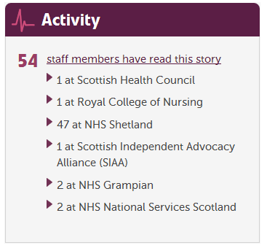
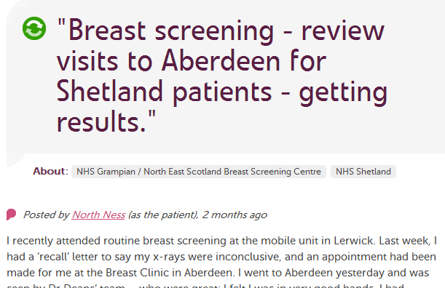

Slide 12
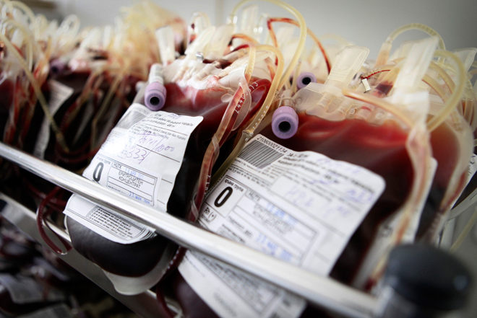

Slide 14
what change?

Slide 15
services

Slide 16
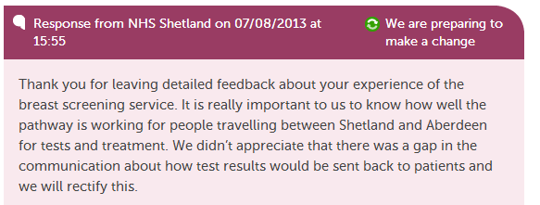

Slide 17
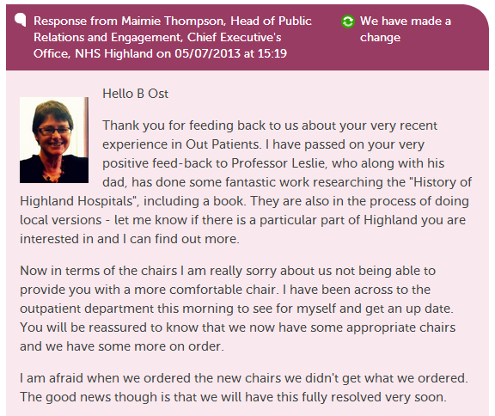

Slide 18
relationships

Slide 19
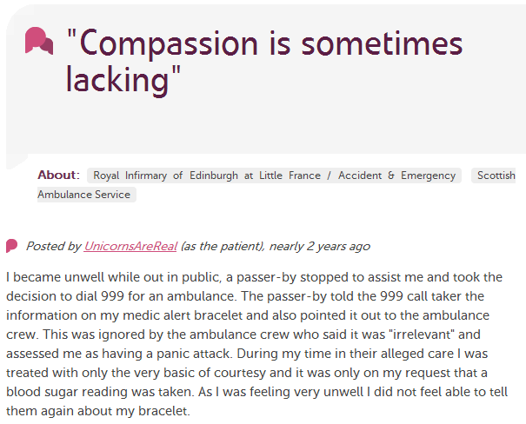
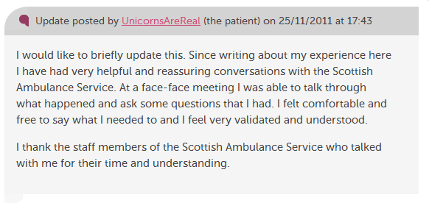

Slide 20
CULTURE

Slide 21
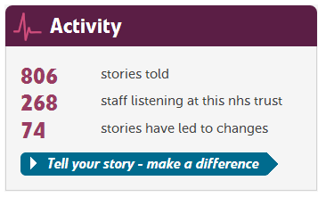

Slide 22
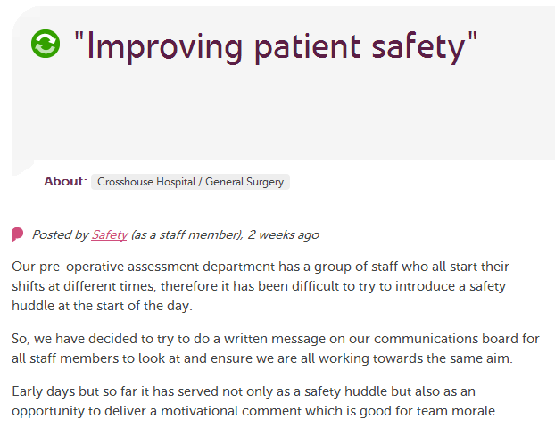

Slide 23
Jane Danforth, involvement officer Nottinghamshire Healthcare NHS Trust
“Patient Opinion is starting to change the way we do things in the trust.
Staff get a real lift from postings that praise what they do. When we can’t do what people ask, we can at least explain why things are the way they are.”

Slide 24
At every level?

Slide 25
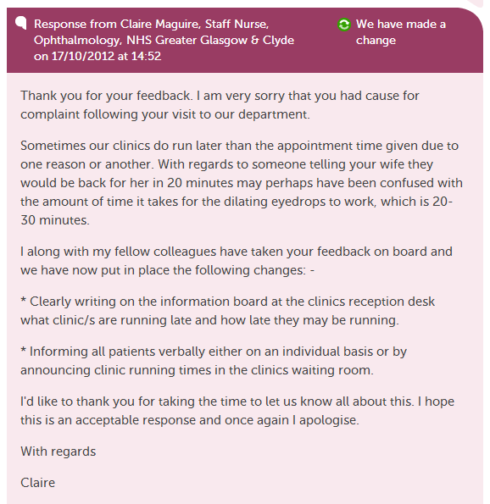

Slide 26
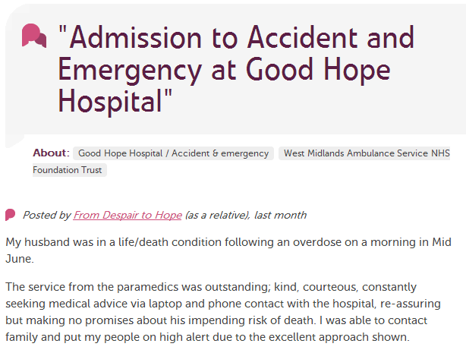
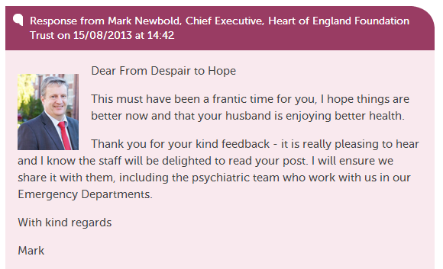

Slide 27
Dr Mark Newbold, chief executive Heart of England NHS Foundation Trust
“We were a little wary at first. We responded, but cautiously.
Now we are engaging actively and finding it very rewarding indeed.”

Slide 28
Policy in a changing world

Slide 29
Francis Report, 2013
“I could not help feeling that, in Francis' vision of the future, the patient remains something of a passive onlooker, not an assertive participant.
It runs the risk of an undue reliance on the system getting it right for the patient. We know all too well that this is not enough.”
Stephen Thornton, chief exec, The Health Foundation

Slide 30
Francis & Transparency
“Patients and the public live a life outside the NHS… The knowledge they make available through web sites like Patient Opinion reflect their experience of what is happening inside, but is also created by their lives outside the health service…
The more knowledge we have about what is going on inside the system that has been created by people who live outside it the better the NHS will be.”
Paul Corrigan, ex-policy advisor to the PM

Slide 31
Keogh Report, July 2013
“Patients, carers and members of the public… should be confident that their feedback is being listened to and see how this is impacting on their own care and the care of others.”

Slide 32
Keogh Report, July 2013
“Realtime patient feedback and comment must become a normal part of provider organisations’ customer service and reach well beyond the Friends and Family Test.”

Slide 33
Berwick Report, August 2013
“Hear the patient voice at every level – even when that voice is a whisper”
Can we do this? Yes we can!

